Slide 1
Unit – II Number Theory
Dr. Nachiket Tapas

Slide 2
Content
Divisibility and Division Algorithm
The Euclidean Algorithm
Modular Arithmetic
Prime Numbers
Fermat’s and Euler’s Theorem
Testing for Primality
The Chinese Remainder Theorem
Discrete Logarithms
Finite Fields

Slide 3
Divisibility and the Division Algorithm
We say that a nonzero b divides a if a = mb for some m, where a, b, and m are integers.
That is, b divides a if there is no remainder on division.
b | a

Slide 4
Properties
If a|1, then a = ±1.
If a|b and b|a, then a = ±1.
Any b ≠ 0 divides 0.
If a|b and b|c, then a|c.

Slide 5
Properties (Contd.)
If b|g and b|h, then b|(mg + nh) for arbitrary integers m and n.
Proof:
If b|g, then g is of the form g = b x g1 for some integer g1.
If b|h, then h is of the form h = b x h1 for some integer h1.
Then:
mg + nh = m x b x g1 + n x b x h1 = b x (mg1 + nh1)
and thus, b divides mg + nh

Slide 6
Example
b = 7; g = 14; h = 63; m = 3; n = 2

Slide 7
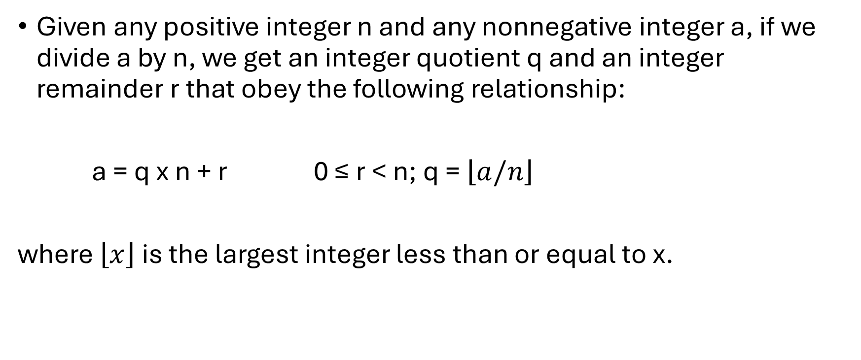
The Division Algorithm
Given any positive integer n and any nonnegative integer a, if we divide a by n, we get an integer quotient q and an integer remainder r that obey the following relationship:
a = q x n + r 0 ≤ r < n; q = $\left\lfloor a/n\right\rfloor$
where $\left\lfloor x\right\rfloor$is the largest integer less than or equal to x.

Slide 8
Example
a = 11; n = 7;

Slide 9
The Euclidean Algorithm
It is a simple procedure for determining the greatest common divisor of two positive integers.
Two integers are relatively prime if and only if their only common positive integer factor is 1.

Slide 10
Greatest Common Divisor
We will use the notation gcd(a, b) to mean the greatest common divisor of a and b.
The greatest common divisor of a and b is the largest integer that divides both a and b.
We also define gcd(0, 0) = 0.

Slide 11
Example
gcd(60, 24) gcd(60, -24)

Slide 12
Algorithm
Suppose we wish to determine the greatest common divisor d of the integers a and b; that is determine d = gcd(a, b). Because gcd(|a|, |b|) = gcd(a, b), there is no harm in assuming a ≥ b > 0.
Dividing a by b and applying the division algorithm, we can state:
a = q1 x b + r1 0 ≤ r1 < b
First consider the case in which r1 = 0. Therefore, b divides a and clearly no larger number divides both b and a, because that number would be larger than b. So, we have d = gcd(a, b) = b.
The other possibility is r1 ≠ 0. For this case, we can state that d|r1. This is due to the basic properties of divisibility: the relations d|a and d|b together imply that d|(a - q1xb), which is the same as d|r1.
Before proceeding with the Euclidian algorithm, we need to answer the question: What is the gcd(b, r1)? We know that d|b and d|r1. Now take any arbitrary integer c that divides both b and r1. Therefore, c|(q1 x b + r1) = a. Because c divides both a and b, we must have c ≤ d, which is the greatest common divisor of a and b. Therefore d = gcd(b, r1).

Slide 13
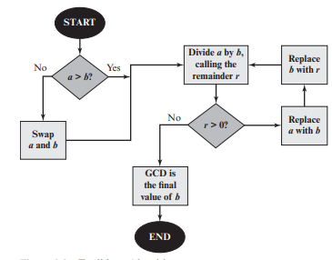
Algorithm (Contd.)

Slide 14
Example
gcd(710, 310)

Slide 15
Modular Arithmetic
If a is an integer and n is a positive integer, we define a mod n to be the remainder when a is divided by n.
11 mod 7 = 4; -11 mod 7 = 3
Two integers a and b are said to be congruent modulo n, if (a mod n) = (b mod n). This is written as a ≡ b (mod n).
73 ≡ 4 (mod 23); 21 ≡ -9 (mod 10)

Slide 16
Properties of Congruences
a ≡ b (mod n) if n | (a - b).
a ≡ b (mod n) implies b ≡ a (mod n).
a ≡ b (mod n) and b ≡ c (mod n) imply a ≡ c (mod n).

Slide 17
Modular Arithmetic
[(a mod n) + (b mod n)] mod n = (a + b) mod n
[(a mod n) - (b mod n)] mod n = (a - b) mod n
[(a mod n) * (b mod n)] mod n = (a * b) mod n

Slide 18
Question
Find 11⁷ mod 13

Slide 19
Question
Find 11⁷ mod 13
11² = 121 ≡ 4 (mod 13)
11⁴ = (11² )² ≡ 4² ≡ 3 (mod 13)
11⁷ = 11 * 11² * 11⁴
11⁷ ≡ 11 * 4 * 3 ≡ 132 ≡ 2 (mod 13)

Slide 20
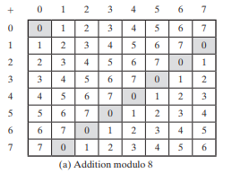
Additive Inverse
(x + y) mod 8 = 0, implies x and y are additive inverse for (mod 8).
Example: (2 + 6) mod 8 = 0

Slide 21
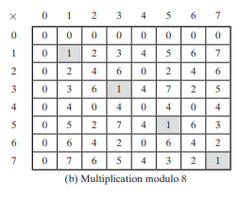
Multiplicative Inverse
(x * y) mod 8 = 1 mod 8, implies x and y are multiplicative inverse.
Example:
(3 * 3) mod 8 = 1

Slide 22
Properties
Set of residues, or residue classes (mod n)
Z_{n} = {0, 1, c , (n - 1)}
The residue classes (mod 4) are
[0] = { ... , -16, -12, -8, -4, 0, 4, 8, 12, 16, ... }
[1] = {... , -15, -11, -7, -3, 1, 5, 9, 13, 17, ... }
[2] = {... , -14, -10, -6, -2, 2, 6, 10, 14, 18, ... }
[3] = {... , -13, -9, -5, -1, 3, 7, 11, 15, 19, ... }

Slide 23
Properties (Contd.)
if (a + b) ≡ (a + c) (mod n) then b ≡ c (mod n) How?
Example:
(5 + 23) ≡ (5 + 7)(mod 8); 23 ≡ 7(mod 8)

Slide 24
Properties (Contd.)
if (a + b) ≡ (a + c) (mod n) then b ≡ c (mod n)
Adding the additive inverse of a to both sides of equation, we have
So, ((-a) + a + b) ≡ ((-a) + a + c)(mod n)
Thus, b ≡ c (mod n)

Slide 25
Properties (Contd.)
Property | Expression
Commutative Laws | (w + x) mod n = (x + w) mod n (w * x) mod n = (x * w) mod n
Associative Laws | [(w + x) + y] mod n = [w + (x + y)] mod n [(w * x) * y] mod n = [w * (x * y)] mod n
Distributive Law | [w * (x + y)] mod n = [(w * x) + (w * y)] mod n
Identities | (0 + w) mod n = w mod n (1 * w) mod n = w mod n
Additive Inverse (-w) | For each w ∈ Z_{n}, there exists a z such that w + z ≡ 0 mod n

Slide 26
Properties (Contd.)
if (a * b) ≡ (a * c)(mod n) then b ≡ c(mod n) if a is relatively prime to n

Slide 27
Properties (Contd.)
if (a * b) ≡ (a * c)(mod n) then b ≡ c(mod n) if a is relatively prime to n
By the definition of congruence, a * b ≡ a * c mod n means that:
a * b − a * c ≡ 0 mod n
This can be rewritten as:
a * (b−c) ≡ 0 mod n
This implies that a * (b−c) is divisible by n, i.e., n divides a * (b−c)

Slide 28
Properties (Contd.)
This implies that a * (b−c) is divisible by n, i.e., n divides a * (b−c)
Since, a and n are relatively prime ( gcd(a, n) = 1 ), n must also divide (b – c)
In other words:
b − c ≡ 0 mod n
This implies:
b ≡ c mod n

Slide 29
Questions
For each of the following equations, find an integer x that satisfies the equation.
5x ≡ 4 ( mod 3)
7x ≡ 6 ( mod 5)
9x ≡ 8 ( mod 7)
Show that an integer N is congruent modulo 9 to the sum of its decimal digits. For example, 475 = 4 + 7 + 5 = 16 = 1 + 6 = 7 (mod 9). This is the basis for the familiar procedure of “casting out 9’s” when checking computations in arithmetic.

Slide 30
Questions (Contd.)
Determine gcd(24140, 16762) using prime factors method and Euclid’s algorithm.
Determine gcd(4655, 12075) using prime factors method and Euclid’s algorithm.

Slide 31
Application of Modular Arithmetic
https://www.youtube.com/watch?v=Pq8gNbvfaoM

Slide 32
Groups, Rings, and Fields

Slide 33
Introduction
Groups, rings, and fields are the fundamental elements of a branch of mathematics known as abstract algebra, or modern algebra.
In abstract algebra, we are concerned with sets on whose elements we can operate algebraically; that is, we can combine two elements of the set, perhaps in several ways, to obtain a third element of the set.

Slide 34
Groups
A group G, sometimes denoted by {G, .}, is a set of elements with a binary operation denoted by . that associates to each ordered pair (a, b) of elements in G an element (a.b) in G, such that the following axioms are obeyed:
(A1) Closure: If a and b belong to G, then a.b is also in G.
(A2) Associative: a . (b . c) = (a . b) . c for all a, b, c in G.
(A3) Identity element: There is an element e in G such that a.e = e.a for all a in G.
(A4) Inverse element: For each a in G, there is an element a’ in G such that a.a’ = a’.a = e.

Slide 35
Example
The group G = {0, 1, 2, 3, 4, 5, 6, 7} under addition modulo 8 is a finite group.
Closure: For any 𝑎,𝑏 ∈ 𝐺, the result of (𝑎+𝑏) mod 8 is also an element of 𝐺. Example: 3 + 5 = 8, and 8 mod 8 = 0, which is in 𝐺.
Associativity: Addition modulo 8 is associative, meaning that for any 𝑎,𝑏,𝑐 ∈ 𝐺, (𝑎 + (𝑏 + 𝑐)) mod 8=((𝑎 + 𝑏) + 𝑐) mod 8. This holds true because addition is naturally associative, and taking modulo does not affect this property.
Identity Element: The identity element in a group is the element that, when combined with any other element, leaves the other element unchanged. In this group, 0 is the identity element because for any 𝑎 ∈ 𝐺, (𝑎 + 0) mod 8 = 𝑎.
Inverse Element: For every element 𝑎 ∈ 𝐺, there exists an element 𝑏 ∈ 𝐺 such that (𝑎 + 𝑏) mod 8=0 (the identity element). For example: The inverse of 0 is 0 because (0 + 0) mod 8 = 0.

Slide 36
Problem
Integers under Addition (Z, +)
Closure: For any two integers 𝑎,𝑏 ∈ 𝑍, their sum 𝑎+𝑏 is also an integer. This means 𝑍 is closed under addition. Example: 3 + (−5) = −2, and −2 is an integer.
Associativity: Addition is associative, meaning that for any 𝑎,𝑏,𝑐 ∈ 𝑍, 𝑎 + (𝑏 + 𝑐) = (𝑎 + 𝑏) + 𝑐. Example: 1 + (2 + 3) = 1 + 5 = 6 and (1 + 2) + 3 = 3 + 3 = 6.
Identity Element: The identity element in (𝑍,+) is 0, because for any 𝑎 ∈ 𝑍, 𝑎 + 0 = 0 + 𝑎 = 𝑎. Example: 4 + 0 = 4 and −7 + 0 = −7.
Inverse Element: For each integer 𝑎 ∈ 𝑍, there exists an inverse element −𝑎 such that 𝑎 + (−𝑎) = 0, where 0 is the identity element. Example: The inverse of 5 is −5 because 5 + (−5) = 0.

Slide 37
Problem
Non-Zero Real Numbers under Multiplication (R, ⋅)
Closure: For any two non-zero real numbers a,b ∈ R, their product a⋅b is also a non-zero real number. Therefore, R is closed under multiplication.
Example: 2 ⋅ 3 = 6 and 6 is a non-zero real number.
Associativity: Multiplication is associative, meaning that for any a,b,c ∈ R, a ⋅ (b ⋅ c) = (a ⋅ b) ⋅ c.
Example: 2 ⋅ (3 ⋅ 4) = 2 ⋅ 12 = 24 and (2 ⋅ 3) ⋅ 4 = 6 ⋅ 4 = 24.
Identity Element: The identity element in (R,⋅) is 1, because for any a ∈ R, a ⋅ 1 = 1 ⋅ a = a.
Example: 7 ⋅ 1 = 7.
Inverse Element: For each non-zero real number a ∈ R, there exists an inverse element 1\a, where a.(1\a) = (1\a).a = 1 is the identity element.

Slide 38
Finite vs Infinite
If a group has a finite number of elements, it is referred to as a finite group, and the order of the group is equal to the number of elements in the group.
Otherwise, the group is an infinite group.

Slide 39
Abelian Group
A group is said to be abelian if it satisfies the following additional condition:
(A5) Commutative: a . b = b . a for all a, b in G.

Slide 40
Cyclic Group
A group is cyclic if every element of is a power ( is an integer) of a fixed element . The element is said to generate the group or to be a generator of G. A cyclic group is always abelian and may be finite or infinite.
Example:
The additive group of integers is an infinite cyclic group generated by the element 1. In this case, powers are interpreted additively, so that is the nth power of 1.

Slide 41
Problem
Problem 1: Prove that in a group G, if (ab)² = a²b² for all a, b ∈ G, then G is abelian.
Problem 2: Let G be a group and let a, b ∈ G. Prove that if ab = ba, then (ab)ⁿ = aⁿbⁿ for all n ∈ Z.

Slide 42
Problem
Problem 1: Prove that in a group G, if (ab)² = a²b² for all a, b ∈ G, then G is abelian.
(ab)(ab)=a²b²
(ab)(ab)=aabb

Slide 43
Rings
A ring R, sometimes denoted by {R, +, *}, is a set of elements with two binary operations, called addition and multiplication, such that for all a, b, c in R the following axioms are obeyed:
(A1–A5) R is an abelian group with respect to addition; that is, R satisfies axioms A1 through A5. For the case of an additive group, we denote the identity element as 0 and the inverse of a as – a.
(M1) Closure under multiplication: If a and b belong to R, then ab is also in R.
(M2) Associativity of multiplication: a(bc) = (ab)c for all a, b, c in R.
(M3) Distributive laws: a(b + c) = ab + ac for all a, b, c in R.
(a + b)c = ac + bc for all a, b, c in R.

Slide 44
Ring (Contd.)
A ring is said to be commutative if it satisfies the following additional condition:
(M4) Commutativity of multiplication: ab = ba for all a, b in R.
We define an integral domain, which is a commutative ring that obeys the following axioms:
(M5) Multiplicative identity: There is an element 1 in such that a1 = 1a = a for all a in R.
(M6) No zero divisors: If a, b in R and ab = 0, then either a = 0 or b = 0.

Slide 45
Fields
A field F, sometimes denoted by {F, +, *}, is a set of elements with two binary operations, called addition and multiplication, such that for all a, b, c in F the following axioms are obeyed:
(A1–M6) is an integral domain; that is, satisfies axioms A1 through A5 and M1 through M6.
(M7) Multiplicative inverse: For each a in F, except 0, there is an element a⁻¹ in F such that a(a⁻¹) = (a⁻¹)a = 1.

Slide 46
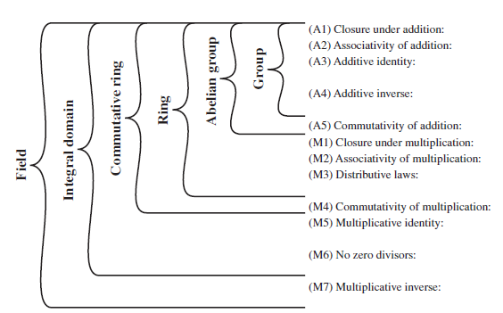
Summary

Slide 47
Problems
Does the set of residue classes ( mod 3 ) form a group
a. with respect to modular addition?
b. with respect to modular multiplication?
Consider the set S = {a,b} with addition and multiplication defined by the following tables. Is a ring? Justify your answer.
+ | a | b
a | a | b
b | b | a
x | a | b
a | a | a
b | a | b

Slide 48
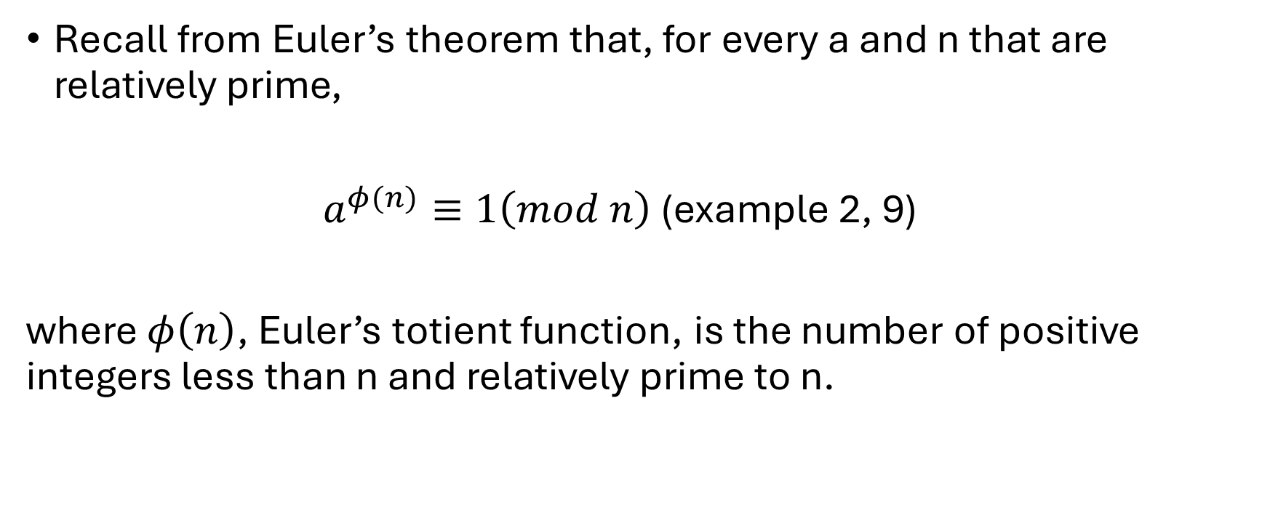
Discrete Logarithms
Recall from Euler’s theorem that, for every a and n that are relatively prime,
$a^{φ(n)}≡1\left(mod n\right)$ (example 2, 9)
where $φ\left(n\right)$, Euler’s totient function, is the number of positive integers less than n and relatively prime to n.

Slide 49
Example
To see this last point, consider the powers of 7, modulo 19:
7¹ = 7 (mod 19)
7² = 49 = 2 * 19 + 11 = 11 (mod 19)
7³ = 343 = 18 * 19 + 1 = 1 (mod 19)
7⁴ = 2401 = 126 * 19 + 7 = 7 (mod 19)
7⁵ = 16807 = 884 * 19 + 11 = 11 (mod 19)

Slide 50
Power of Integers, Modulo 19

Slide 51
Power of Integers, Modulo 19
Some of the sequences are of length 18. In this case, it is said that the base integer a generates (via powers) the set of non-zero integers modulo 19. Each such integer is called a primitive root of the modulus 19.
For the prime number 19, its primitive roots are 2, 3, 10, 13, 14, and 15.

Slide 52
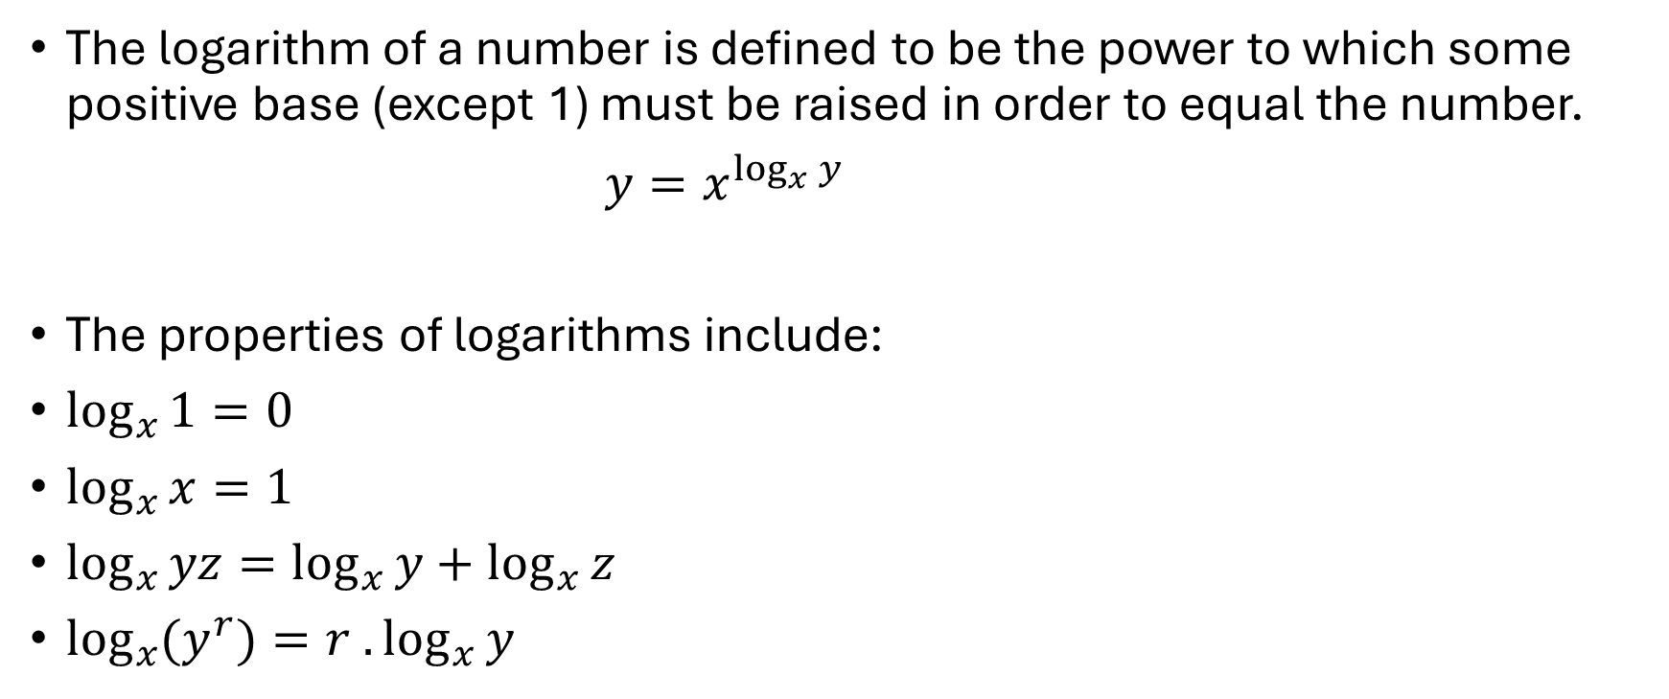
Logarithms for Modular Arithmetic
The logarithm of a number is defined to be the power to which some positive base (except 1) must be raised in order to equal the number.
$y=x^{\log_{x}{y}}$
The properties of logarithms include:
$\log_{x}{1}=0$
$\log_{x}{x}=1$
$\log_{x}{yz}=\log_{x}{y}+\log_{x}{z}$
$\log_{x}{{(y}^{r})=r .\log_{x}{y}}$

Slide 53
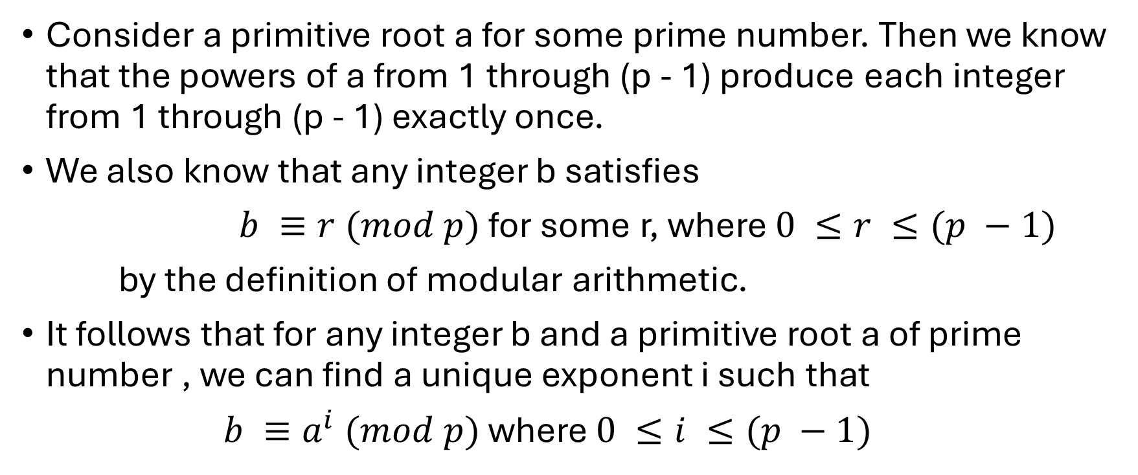
Logarithms for Modular Arithmetic
Consider a primitive root a for some prime number. Then we know that the powers of a from 1 through (p - 1) produce each integer from 1 through (p - 1) exactly once.
We also know that any integer b satisfies
$b ≡r (mod p)$ for some r, where $0 ≤r ≤(p −1)$
by the definition of modular arithmetic.
It follows that for any integer b and a primitive root a of prime number , we can find a unique exponent i such that
$b ≡a^{i} (mod p)$ where $0 ≤i ≤(p −1)$

Slide 54

Logarithms for Modular Arithmetic
This exponent i is referred to as the discrete logarithm of the number b for the base a (mod p).
We denote this value as ${dlog}_{a,p}\left(b\right)$

Slide 55
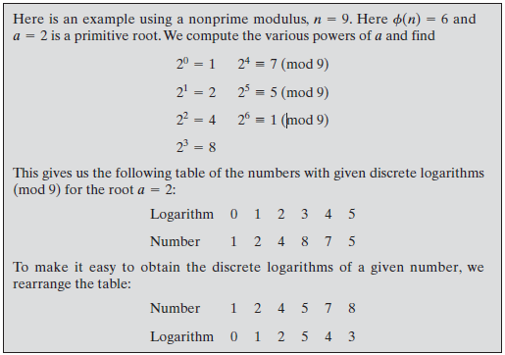
Example

Slide 56

Problem
Given 2 as a primitive root of 29, construct a table of discrete logarithms, and use it to solve the following congruences.
$$17x^{2} ≡10 (mod 29)$$

Slide 57
Solution
Logarithm | Number
0 | 1
1 | 2
2 | 4
3 | 8
4 | 16
5 | 3
6 | 6
7 | 12
8 | 24
9 | 19
10 | 9
11 | 18
12 | 7
Logarithm | Number
13 | 14
14 | 28
15 | 27
16
17
18
19
20
21
22
23
24
25

Slide 58

Solution
Logarithm | Number
26
27
28
$$17x^{2} ≡10 (mod 29)$$

